Slide 1

RisingWave: Cloud-Native Streaming Database
A look at RisingWave, a new cloud-native streaming database designed to simplify, reduce the cost, and increase the accessibility of stream processing.

Slide 2

Democratizing Stream Processing
RisingWave aims to make stream processing simple, affordable, and accessible by:
Treating streams as first-class citizens in a database.
Using a PostgreSQL-compatible SQL interface.
Allowing users to create streaming analytical tasks by defining materialized views.
These views are incrementally maintained in the RisingWave streaming engine and can be queried directly without exporting to an external system.

Slide 3
Addressing the Challenges of Stream Processing
Difficult to Learn
Expensive to Operate
Most streaming systems require users to learn low-level programming APIs, unlike DBMSes with SQL interfaces.
Deploying and maintaining a streaming system is costly, requiring many machines and a specialized operative team.

Slide 4
Ingesting & Converting Streaming Data
RisingWave can ingest streaming data in various formats:
JSON, Protobuf, and Avro data formats are supported natively.
As soon as data is ingested, RisingWave automatically transforms raw data into relational rows, meaning you don’t have to write complex ETL logic just to query your streams.

Slide 5

RisingWave's Key Features
SQL Interface
Tiered Architecture
PostgreSQL compatible, seamlessly integrating with the PostgreSQL ecosystem.
Decoupled components for independent scaling and reduced costs.
Open Source
Built in Rust and open-sourced under Apache License 2.0.

Slide 6
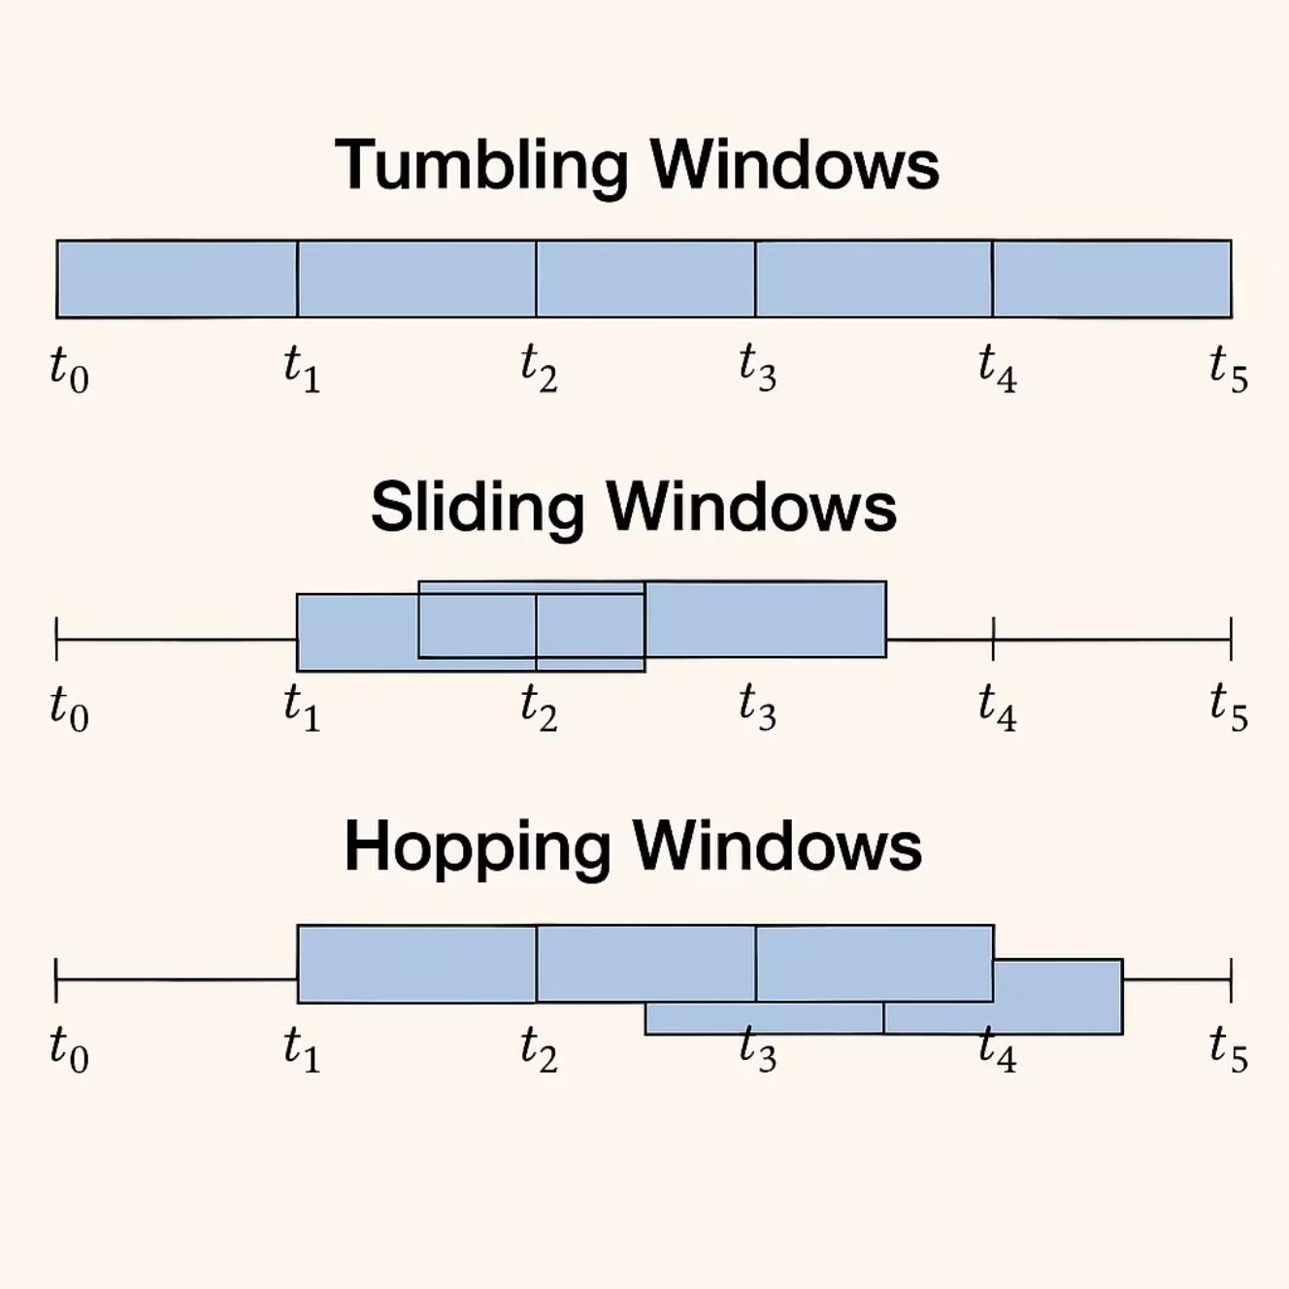
Streaming SQL with Native Windows
💡 RisingWave supports native window functions for real-time streaming queries:
🔹 Tumbling Windows
Fixed-size, non-overlapping intervals
E.g., Avg. sales every 10 minutes
🔹 Sliding Windows
Overlapping windows with frequent updates
E.g., Max CPU usage over last 5 mins, updated every 30 sec
🔹 Hopping Windows
Periodic overlapping intervals
E.g., Rolling 10-min CTR calculated every 3 minutes
✅ Why It Matters
Enables time-based aggregations using just SQL
Simplifies real-time analytics with continuous updates
No need for external processing frameworks

Slide 7
Advanced PostgreSQL Integration
This deep compatibility allows analysts and engineers already familiar with PostgreSQL to use RisingWave immediately without retraining or retooling.
RisingWave is not just SQL-compatible in a basic sense—it deeply integrates with PostgreSQL:
It supports most PostgreSQL data types, including both basic (e.g., INTEGER, VARCHAR, BOOLEAN) and compositional types (e.g., arrays, records).
RisingWave can run 20 of the 22 standard TPC-H benchmark queries—a widely accepted performance and functionality test set in the database industry.
It uses the standard PostgreSQL client protocol, meaning users can directly use existing tools like psql without needing to install or learn a new client.

Slide 8
PostgreSQL Query Compatibility
Deep integration with PostgreSQL syntax and semantics
Supports advanced data types:
Arrays, records, and other compositional types
Uses standard PostgreSQL client protocols (e.g., psql)
Successfully runs 20 of the 22 TPC-H benchmark queries
Proves RisingWave’s ability to handle complex SQL analytics

Slide 9
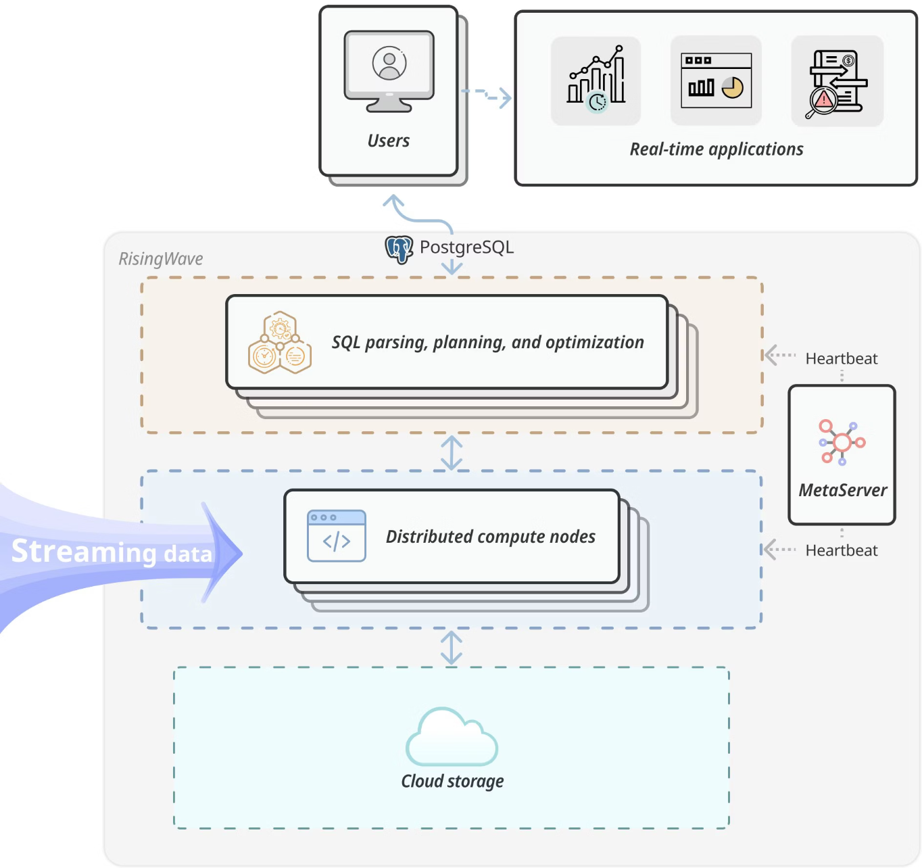
RisingWave Architecture
RisingWave consists of two computation engines: a batch engine for ad-hoc queries and a streaming engine for continuously updating materialized views.
The kernel is decoupled into frontend, compute engine, storage service, compaction service, and meta service.

Slide 10
Key Components: Frontend and Compute Nodes
Frontend Nodes
Compute Nodes
Connect to PostgreSQL clients, parse SQL, and redirect statements to batch or streaming engines.
Host both the batch engine (vectorized query execution) and the streaming engine (actor model-based).

Slide 11
Frontend Nodes in RisingWave
🔹 What Are Frontend Nodes?
Frontend nodes are the entry point for user queries. They act like the brain that translates SQL into executable workflows.
🔍 Key Responsibilities of Frontend Nodes:
SQL Parsing & Planning
Accepts SQL queries directly from PostgreSQL clients (psql or apps).
Parses SQL queries and generates logical plans.
Optimizes and converts logical plans into physical execution plans.
Metadata Caching
Frontend nodes cache metadata from the meta service.
This includes table schemas, view definitions, and system configuration.
Caching improves performance and reduces overhead.
Query Routing
Frontend decides where the computation should run.
It sends the execution plan to the appropriate Compute Nodes.
Dual Query Support
Supports both ad-hoc SQL queries and materialized views.
Materialized views are registered and tracked in the meta service.
💡 Analogy:
You can think of Frontend Nodes as the “planner and dispatcher” in a restaurant. They take your order (SQL), check the kitchen status (metadata), and forward the instructions to the chef (compute node).

Slide 12
How Frontend Nodes Plan and Dispatch Queries
Frontend nodes parse SQL queries from PostgreSQL clients
Three-step process:
Generate logical plan from SQL
Optimize to create an execution plan
Schedule query to compute nodes
For materialized views:
Builds streaming workflows using an actor graph
Deploys workflows for continuous computation

Slide 13
Compute Nodes in RisingWave
🔹 What Are Compute Nodes?
Compute nodes are the execution engines of RisingWave. They run the actual computation on the data — either in batch or streaming mode.
⚙️ Two Engines Inside Compute Nodes:
1. Batch Engine Runs ad-hoc analytical queries (e.g., SELECT, aggregates, joins).
Fully vectorized and parallelized, processing multiple rows at once.
Similar in architecture to modern OLAP databases.
2. Streaming Engine Continuously processes materialized views in real-time.
Uses an actor-based architecture:
Each unit of processing is called an actor.
Actors are independent, stateful, and event-driven.
They communicate through message passing, not shared memory.
Actors are deployed and scheduled dynamically by the meta service.

Slide 14
🔁 Checkpointing & Fault Recovery Compute nodes save state to Hummock using barrier-based snapshots.
If a crash happens, compute nodes roll back to a previously saved consistent state.
Guarantees exactly-once processing semantics for materialized views.
📶 Compute Node Lifecycle: Receives plan from Frontend
Spawns actors for the job
Pulls data from source (e.g., Kafka)
Applies transformations
Pushes results to materialized views or back to user
💡 Analogy: Compute Nodes are the chefs in the kitchen, actively cooking and updating dishes (results) based on real-time orders and changes.

Slide 15
Crash Recovery with Asynchronous Checkpoints
RisingWave uses Asynchronous Barrier Snapshot for:
Refreshing materialized views
Recovering from system crashes
Guarantees exactly-once processing semantics
If a crash occurs, RisingWave:
Restores system state to the last consistent checkpoint
Rebuilds all actors and resumes streaming
Ensures data consistency and high availability

Slide 16
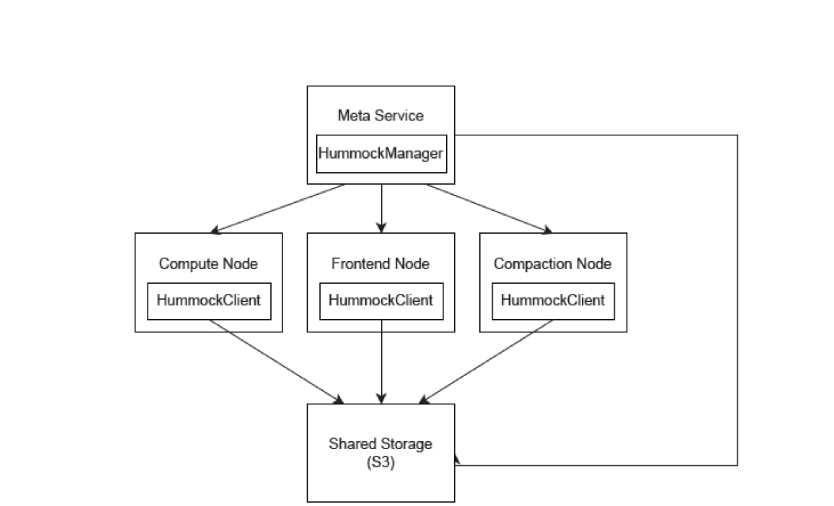
Hummock: Cloud-Native Storage Service
Hummock provides a unified key-value interface for storing and accessing data, combining shared cloud storage with tiered caches.
Optimized for streaming workloads with a write path similar to LSM-tree and extensive use of tiered cache for read requests.

Slide 17
Inside Hummock – Storage for Streaming Workloads
Hummock is a cloud-native storage engine built for streaming workloads
Combines:
Shared cloud storage (e.g., AWS S3)
Tiered caching for fast reads
LSM-tree–like write path for write optimization
Supports:
Low latency
Infinite storage scalability
Strong consistency

Slide 18
Meta Service and Consistency
Meta Service
Consistency
A centralized service that stores metadata and coordinates distributed services, using etcd for durable storage and strong consistency.
RisingWave guarantees snapshot-based consistency over materialized views, ensuring sensible answers from queries.

Slide 19
Meta Service – The Coordinator of the Cluster
The Meta Service stores cluster-wide metadata
Responsibilities:
Maintains system catalog and cluster membership
Schedules compute and compaction tasks
Coordinates recovery, epochs, and barrier checkpoints
Uses etcd for durable key-value storage with strong consistency
Because of the meta service, other nodes are stateless and replaceable, which improves system flexibility and scaling in the cloud.

Slide 20

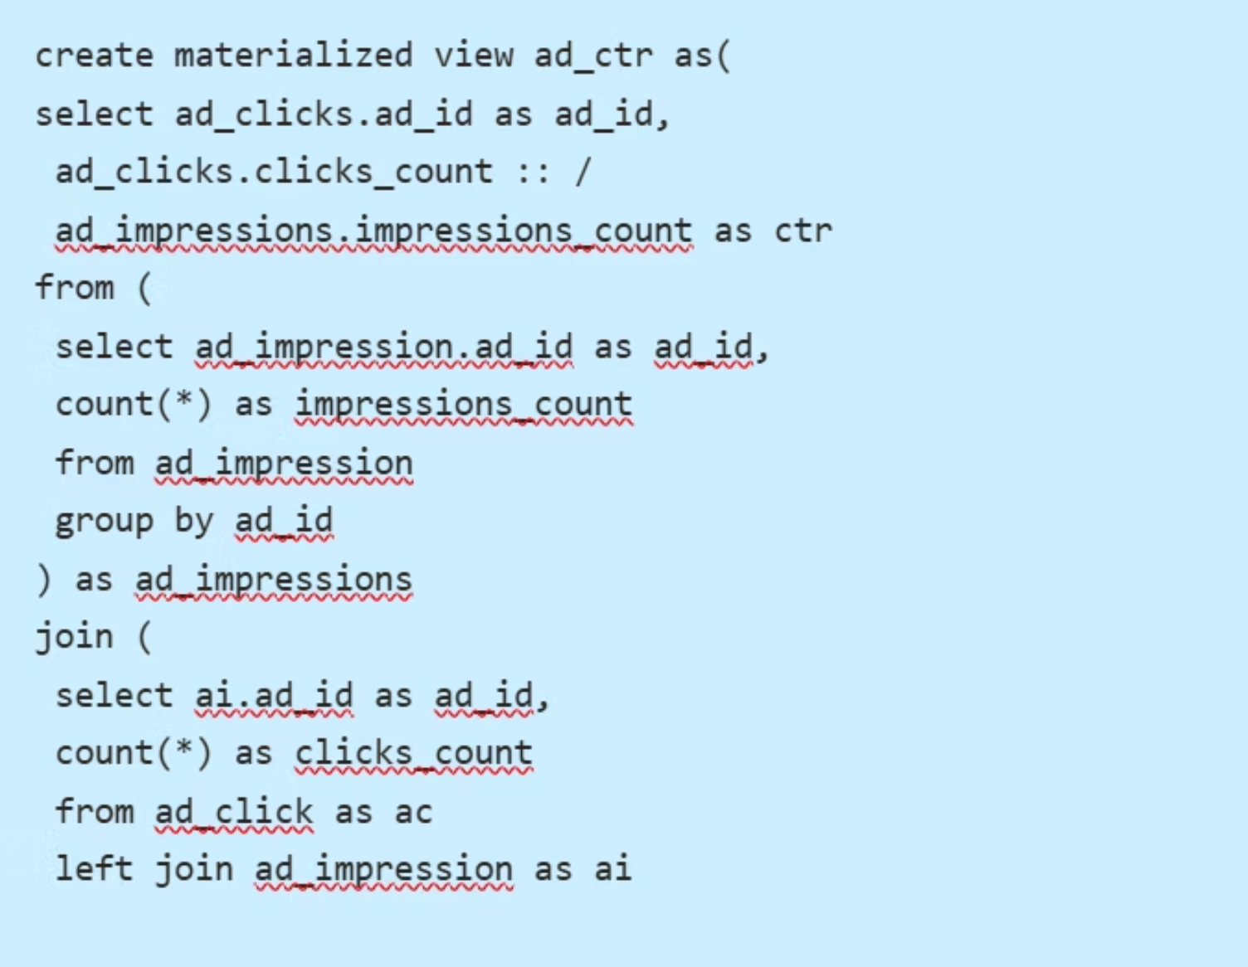
Demonstration: Real-Time CTR Calculation
Users can access RisingWave via local psql clients and issue SQL statements to declare sources, create materialized views, and query real-time results.
Example: Calculating the click transformation rate (CTR) of displayed advertisements in real-time using SQL statements.

Slide 21
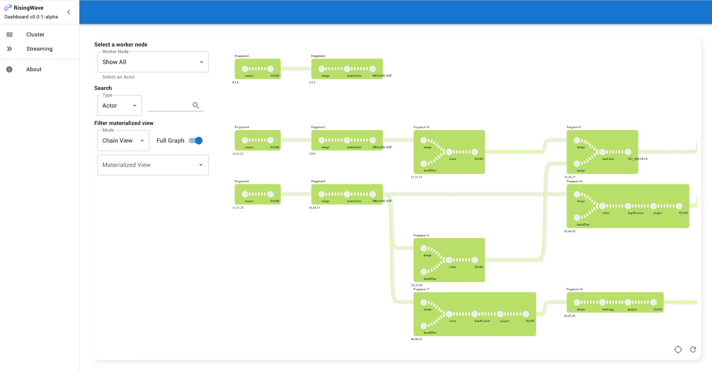
Streaming Workflow Visualization in RisingWave
🎯 RisingWave auto-generates a streaming workflow for each SQL-based materialized view.
📦 Each green block represents a processing fragment (e.g., source, merge, materialize, join, window, project).
🔁 Fragments are executed by actors—lightweight, independent tasks scheduled across compute nodes.
🧠 The graph shows data dependencies, actor links, and execution order in real time.
⚙️ Workflow is optimized for parallel execution, fault tolerance, and exactly-once consistency.
📊 Users can monitor this execution plan via the RisingWave Dashboard UI for visibility and debugging.

Slide 22

Future Roadmap – What’s Next for RisingWave
🌐 Richer SQL Support
More TPC-H queries
User-defined functions (UDFs)
Role-based access control
📦 Schemaless Sources
Auto-infer schema from incoming JSON/Protobuf
Reduces manual setup
🤖 Adaptive Stream Processing
Smart pipeline optimization
Respond to unknown stream patterns on-the-fly

Slide 23
Rust-Based & Open Source Foundation
RisingWave is developed in Rust for safety, performance, and concurrency
Uses Rust's asynchronous runtime to scale actor-based workflows
Open-sourced under the Apache License 2.0
Promotes community-driven development and transparency

Slide 24
RisingWave: Powering Real-Time Data
RisingWave is redefining stream processing by making real-time analytics simple, accessible, and efficient for everyone. It combines a cloud-native architecture with the familiar power of SQL, turning complex streaming challenges into streamlined, developer-friendly solutions.
🌐 Cloud-Native & Scalable
Built for the modern cloud with elastic scaling and cost efficiency, adaptable to diverse real-time workloads.
💡 SQL for Streams
Leverages PostgreSQL-compatible SQL to simplify development and accelerate real-time pipeline creation.
📊 Real-Time Operational Insights
Delivers low-latency analytics and actionable intelligence—empowering smarter, faster decisions.
🔁 Reliable & Fault-Tolerant
Guarantees data consistency and resilience through innovations like Hummock storage and asynchronous checkpoints.
🔮 The Road Ahead
RisingWave continues to evolve with support for:
Richer SQL functionalities
Schemaless data ingestion
Adaptive, self-optimizing stream processing
🏁 Conclusion
RisingWave is not just a tool — it's a platform reshaping how we build and scale real-time analytics.

Slide 25
REFERENCES
[1] 2022. Apache Kafka. https://kafka.apache.org/.
[2] 2022. Apache Pulsar. https://pulsar.apache.org/.
[3] 2022. AWS Kinesis. https://aws.amazon.com/kinesis/.
[4] 2022. Debezium. https://debezium.io/.
[5] 2022. etcd. https://etcd.io/.
[6] 2022. Redpanda. https://redpanda.com/.
[7] 2022. RisingWave source code. https://github.com/singularity-data/risingwave.
[8] Paris Carbone, Gyula Fóra, Stephan Ewen, Seif Haridi, and Kostas Tzoumas. 2015. Lightweight asynchronous snapshots for distributed dataflows. arXiv preprint arXiv:1506.08603 (2015).
[9] Paris Carbone, Asterios Katsifodimos, Stephan Ewen, Volker Markl, Seif Haridi, and Kostas Tzoumas. 2015. Apache flink: Stream and batch processing in a single engine. Bulletin of the IEEE Computer Society Technical Committee on Data Engineering 36, 4 (2015).
[10] Carl Hewitt, Peter Bishop, and Richard Steiger. 1973. A universal modular actor formalism for artificial intelligence. In Proceedings of the 3rd international joint conference on Artificial intelligence. 235–245.
[11] Frank McSherry. 2020. Eventual Consistency isn’t for Streaming. https://materialize.com/eventual-consistency-isnt-for-streaming/.
[12] Matei Zaharia, Tathagata Das, Haoyuan Li, Timothy Hunter, Scott Shenker, and Ion Stoica. 2013. Discretized streams: Fault-tolerant streaming computation at scale. In Proceedings of the twenty-fourth ACM symposium on operating systems principles. 423–438.

